Slide 1



Anil Kumar_Exhaustive Analysis of Indian Agriculture Using Power BI

Slide 2

Learning Objectives
Data Exploration: Explored data using Power BI visuals like tables to understand state, district, and yearly data structure.
Major-Crops Analysis: Analyzing the trends in the cultivation of major crops, including rice, wheat, and pulses, focusing on changes in area, production, and yield.
State Analysis: Analyze state-wise crop cultivation patterns and production levels.
Seasonal Analysis: Explore seasonal patterns in crop cultivation, considering kharif and rabi seasons.
GOAL
Source :
www.freepik.com/

Slide 3
Tools and Technology used
Microsoft Excel – Cleaning and structuring CSV files before importing into Power BI.
Power BI Desktop – Creating dashboards, reports, and interactive visualizations.
Power Query (in Power BI) – Cleaning, merging, and transforming raw data.
Power BI Service (Cloud-Based Sharing) – Publishing dashboards for stakeholders.

Slide 4
Methodology
The methodology involves data collection, cleaning, and modeling using Power BI to structure agricultural data efficiently. A data model is designed with fact and dimension tables, establishing relationships for efficient analysis. Interactive visualizations (charts, graphs, heatmaps, and geospatial maps) are created in Power BI for insights into crop production, seasonal trends, and policy impacts. Finally, forecasting techniques and Power BI dashboards provide actionable insights for farmers and agribusinesses to access real-time insights.

Slide 5
Problem Statement:
How can we identify the top-performing and underperforming states and districts in terms of crop production and yield?
How can we identify variations in crop production and yield across different states and districts in India?
Which regions are most suitable for specific crops, and how can we optimize land usage?
How do seasonal variations (Kharif, Rabi, Zaid) affect different crops in various regions?

Slide 6
Solution:
Analyze crop production trends across states and seasons.
Visualize district-wise production using geospatial maps.
Use bar charts and line graphs to compare crop production over different years.
Use geospatial maps to visualize crop production by state/district.
Compare soil type, climate data, and irrigation availability with crop yields.
Compare seasonal production trends using stacked column charts.
Forecast seasonal variations using time-series analysis.

Slide 7
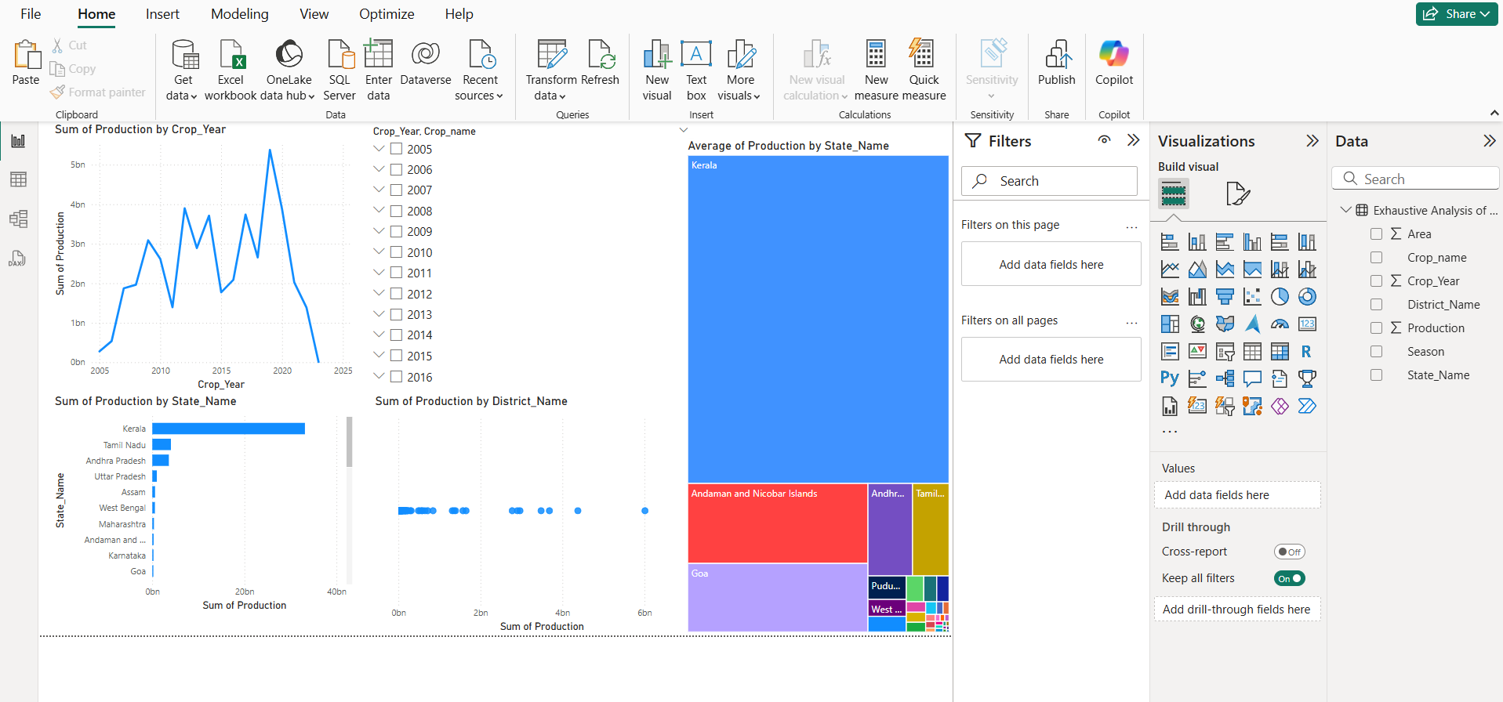
Screenshot of Output:

Slide 8
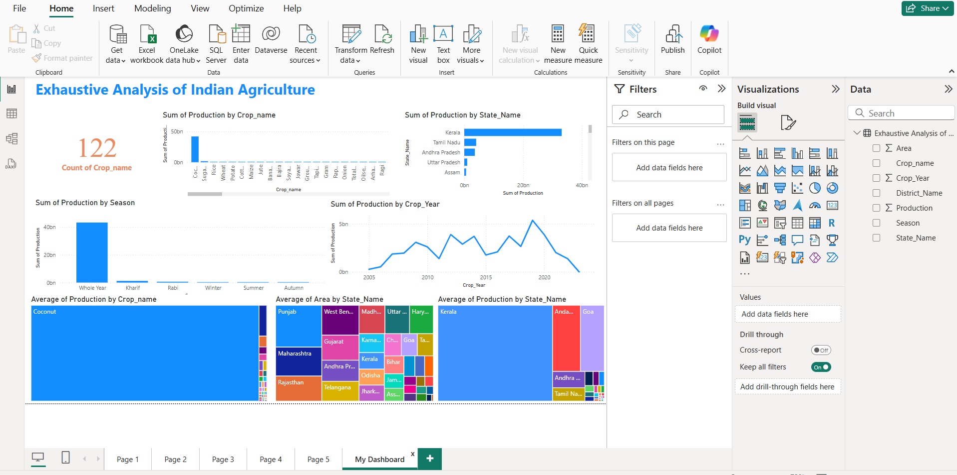
Screenshot of Output:

Slide 9
Conclusion:
This project provides interns with an opportunity to gain hands-on experience in agricultural data analysis and visualization using Power BI, contributing valuable insights to enhance agricultural practices and decision-making in India .

